Slide 1
Presentation 6
Development and quality plans
Development plan and quality plan objectives
The elements of the development plan
Elements of the quality plan
Development and quality plans for small and for internal projects
Software development risks and software risk management

Slide 2
Development and quality
plans - Objectives
Planning is meant to prepare adequate foundations for successful and timely completion of the project. The planning process includes:
1. Scheduling development activities and estimating the
required manpower resources and budget
2. Recruiting team members and allocating development
resources
3. Resolving development risks
4. Implementing required SQA activities
5. Providing management with data needed for project
control

Slide 3
The elements of a
development plan
1. Project products, specifying “deliverables”
2. Project interfaces
3. Project’s methodology and development tools
4. Software development standards and procedures
5. Map of the development process
6. Project milestones
7. Project staff organization and coordination with external participants
8. Required development facilities
9. Development risks and risk management actions
10. Control methods
11. Project cost estimates

Slide 4
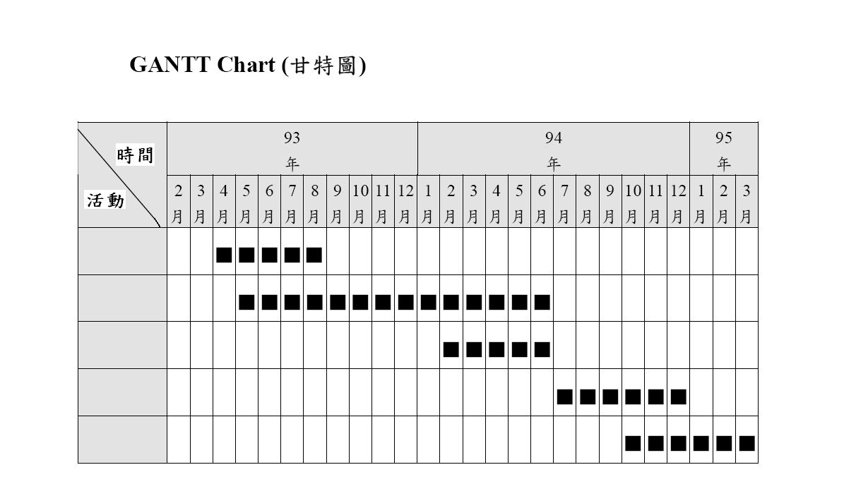

Slide 5
earliest starting time
latest starting time
[6, 15]
[8, 17]
E
5 days
2 days
H
[13, 22]
[0, 9]
B
6 days
4 days
3 days
A
4 days
11 days
J
7 days
F
C
[5, 20]
16 days
5 days
2 days
[0, 15]
Activity
D
G
3 days
Milestone
[2, 17]
critical path
PERT Chart

Slide 6
[6, 15]
[8, 17]
E
5 days
2 days
H
[13, 22]
[0, 9]
B
6 days
4 days
3 days
A
4 days
11 days
J
7 days
F
C
[5, 20]
16 days
5 days
17 days
Activity
D
G
3 days
Milestone
[2, 17]
critical path
Updated PERT Chart at day 17

Slide 7
The elements of a
development plan for small projects
1. Project products, indicating “deliverables”
2. Project benchmarks
3. Development risks
4. Project cost estimates

Slide 8
The elements of a
software quality plan
1. List of quality goals
2. Review activities
3. Software tests
4. Acceptance tests for software
externally developed
5. Configuration management plans: tools, procedures and dates for version release

Slide 9
Some quality plan's elements must be coordinated
with the development process
The schedule of review and software activities should be coordinated with the schedule for completion of the software products (documents and code).
Correction should also be coordinated with the review and test activities.
- The configuration management activities and especially the release of planned baseline versions of the software system must be coordinated with the progress of the development process and the completion of the production of the relevant software products.

Slide 10
Classes of software
development risks
A. Scheduling and timing risks
B. System functionality risks
C. Subcontracting risks
D. Requirement management risks
E. Resource usage and performance risks
F. Personnel management risks

Slide 11
Boehm and Ross's
Top 10 software risk items
1. Unrealistic schedules and budgets (A)
2. Developing wrong software functions (B)
3. Developing wrong user interface (B)
4. Shortfalls in externally furnished components (C)
5. Shortfalls in externally performed tasks (C)
6. Gold plating (D)
7. Continuing stream of requirement changes (D)
8. Real-time performance shortfalls (E)
9. Straining computer science capabilities (E)
10. Personnel shortfalls (F)

Slide 12
The software risk
management process
New
project
Pre
-
Risk identification
project
and assessment
Planning risk
Planning and updating risk
management activities
management activities
Ongoing
projects
Implementing
risk management actions
Identifying and
(risk resolution)
assessing new software
risks
Monitoring software risk
management activities
Required results
achieved
Evaluate
Unsatisfactory results
monitoring
results

